Slide 1


Approval AI Project
Harlan Wittlieff
Data Science, Bellevue University
DSC 680: Applied Data Science
Dr. Catie Williams
June 26, 2022
Notes:
Good afternoon. For those of you who do not know me, I am Harlan Wittlieff and I am a Data Scientist here at Loans Today.
I am here today to speak to you about an exciting initiative at Loans Today called the “Approval AI Project”

Slide 2
Purpose
Goal to create an algorithm to predict loan status as approved, yes or no
Streamline loan application review process
Utilize for first stage of screening loan applications to weed out clearly unqualified loan applications
Loan Officers focus on reviewing borderline or fully qualified loan applicants
Notes:
The purpose to the Approval AI Project is to create an algorithm to predict a loan status application as approved, yes or no.
This automation project will streamline the loan application review process.
Our bank has grown substantially over the years, and our current staffing model is not currently adequate to accommodate this unprecedented growth.
Therefore, to provide much need assistance to our valued Loan Officers, we are investigating methods to help balance their workloads.
This algorithm will be leveraged in the first stage of screening loan applications to essentially weed out the obvious unqualified loan applications, leaving the borderline or fully qualified loan applicants for Loan Officer review.
This will lessen the time spent reviewing applications that clearly do not meet our loan approval requirements.

Slide 3
Key Considerations
Benefits
Increase operations scalability at Loans Today
Support the Loan Officer team
Remove process bottlenecks
Risks
Loan Approval ≠ Loan Profitability
False rejections
Ethics
Livelihood impact
Avoid unfair biases
Notes:
As we look toward implementing this algorithm, there are key points for consideration.
First, the potential benefits of this project. If successful, we will be able to increase the scalability of our operations at Loans Today. This sets us up for success as we continue along this exponential company growth projectory.
Additionally, the automated screening will support the Loan Officer team, providing them with enhanced process efficiency and removing bottlenecks from the loan application review process.
The risks of this project must also be considered. For instance, loan approval does not necessarily always equate to loan profitability for the bank. We also risk false rejections by the model.
Finally, the ethical considerations must also be taken into account. Loans impact the livelihood of individuals. Therefore, the decision on whether an applicant qualifies for a loan is not to be taken lightly. We must also ensure that we avoid any unfair biases within the model.
With these key considerations in mind, let us next explore the dataset and models used to achieve our project goals.

Slide 4
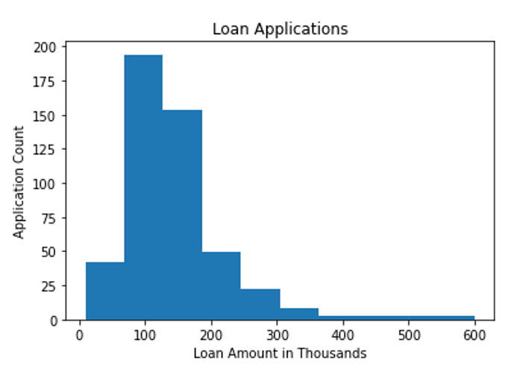
Data
“Loan Approval Data Set” – Kaggle
614 applications for loans
Loan amount range: $9k - $600k
“Loan Status” – Target Variable
Preparation
Removed null records
Created dummy variables
Split into training & test datasets
Notes:
The dataset used for the Approval AI Project comes from Kaggle.
The Loan Approval Data Set consists of data from 614 loan applications for loan amounts ranging from nine thousand dollars to six hundred thousand dollars.
The dataset features the key variables included on the Loans Today loan application. These variables include:
Loan ID
Gender
Married
Dependents
Education
Self Employed
Applicant Income
Co-applicant Income
Loan Amount
Loan Amount Term
Credit History
Property Area
Loan Status
Loan Status is the target variable for the model.
To begin preparing this dataset for modeling, I removed all null records. The most substantial transformation the dataset required was the creation of dummy variables due to many of the fields containing categorical data such as gender, married, if a graduate, self-employed, and property area. The final transformation was to split the dataset into training and testing datasets.

Slide 5
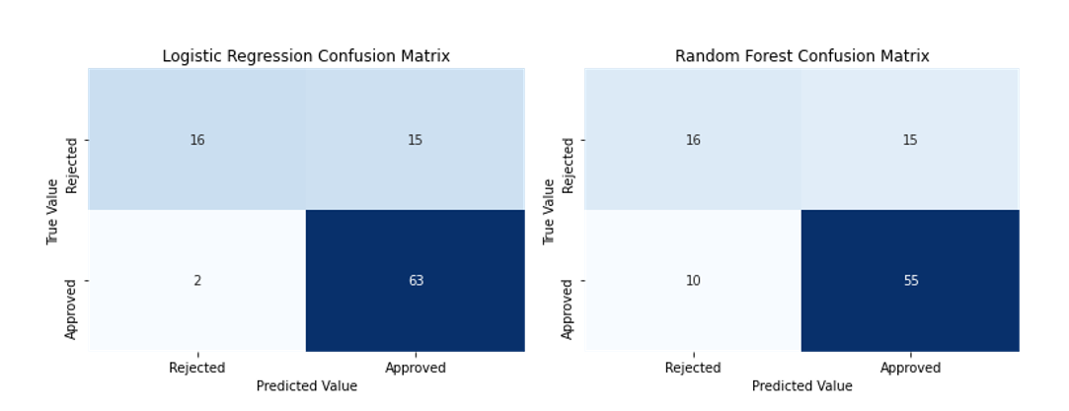
Models & Results
Logistic Regression
Accuracy Score = 82%
Identified 63 of 65 loans for approval
Incorrectly approved 15 of 31 loans
Random Forest Model
Accuracy Score = 74%
Same false positives
Falsely rejected 8 additional applications
Notes:
With the data preparation complete, I moved into building the models. I first built a Logistic Regression. I elected to also construct a Random Forest Model for comparison.
To evaluate the success of the models, I calculated the accuracy scores and created a confusion matrix to view the model performance on the test data set.
The Logistic Regression achieved the higher accuracy score of the two models at 82%. This model also performed better based on the number of applications that were incorrectly rejected when compared to the Random Forest Model.

Slide 6
Recommendations
Model for Implementation: Logistic Regression Model
Low chance of falsely rejecting loan applications
Track loan repayment status & leverage to increase model profitability
Launch model as initial filter
Additional Applications
Determine optimal loan terms
Expand model for lower loan amounts
Notes:
Considering the model results, I recommend the Logistic Regression Model for implementation.
This model demonstrates a lower chance of falsely rejecting loan applications that should actually be considered for approval.
I recommend that Loans Today track loan repayment statuses and leverage the data to increase the model profitability.
The recommended approach for this implementation is to launch the model as an initial filter of the loan applications and not as the final decision maker. Our Loan Officers will still ultimately determine which of the loan applications will be approved based on the preapprovals from the model.
There are potential areas to consider additional applications. For example, the model could be made more robust to determine optimal loan terms such as APR and repayment schedule. The model could also be expanded for smaller loan amounts.

Slide 7
Concluding Remarks
Approval AI is the first data science project of many to help make our bank scalable for future growth.
Thank you for joining us on this exciting journey toward the launch of our first major automation initiative at Loans Today!

